Slide 1



Osquery for Endpoint Visibility and Threat Analysis IIT Jammu: Sec Workshop 22-23rd February 2023 Prof. Manjesh K. Hanawal IIT Bombay

Slide 2
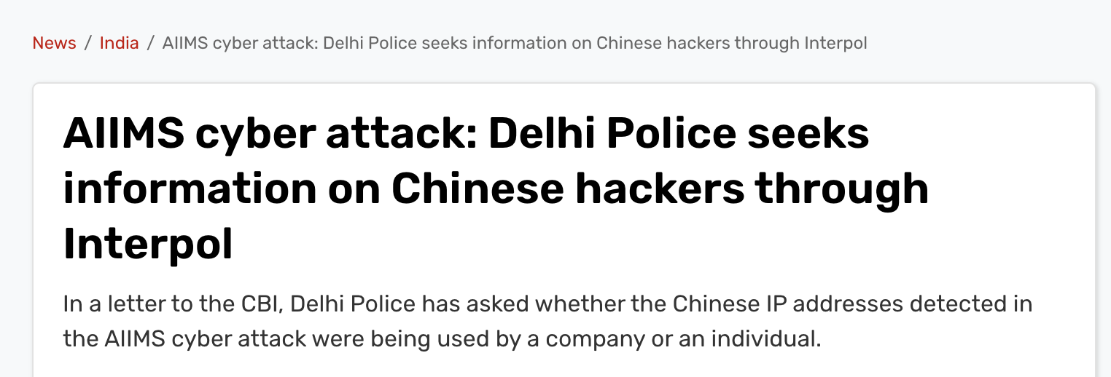
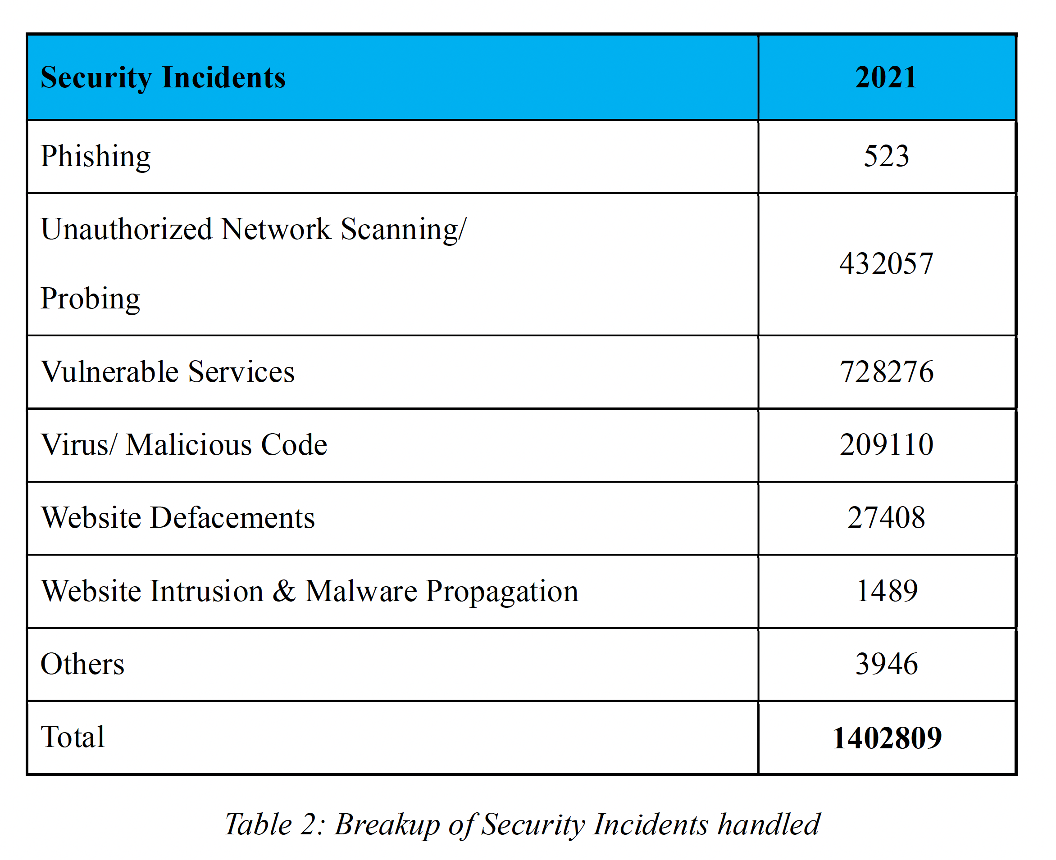
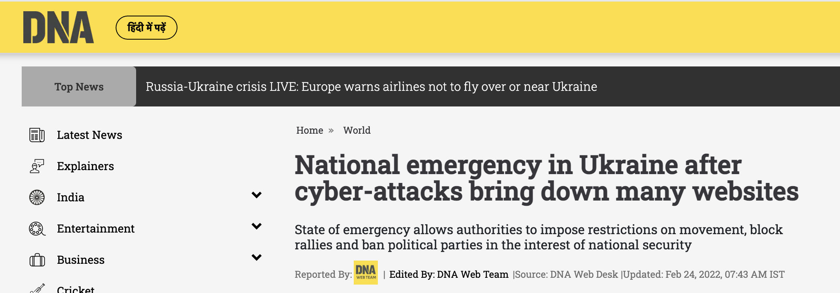
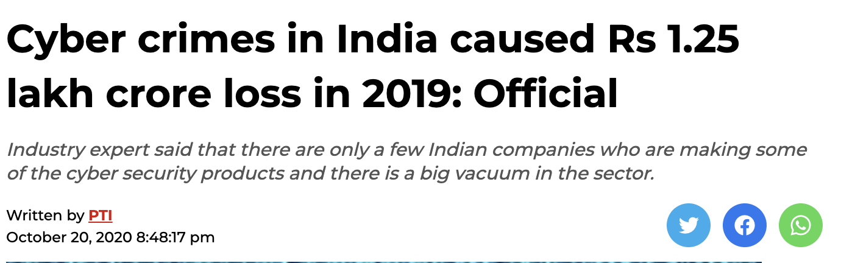
Cyber security and threats
CERT-IN annual report 2021
Image sources: Internet

Slide 3
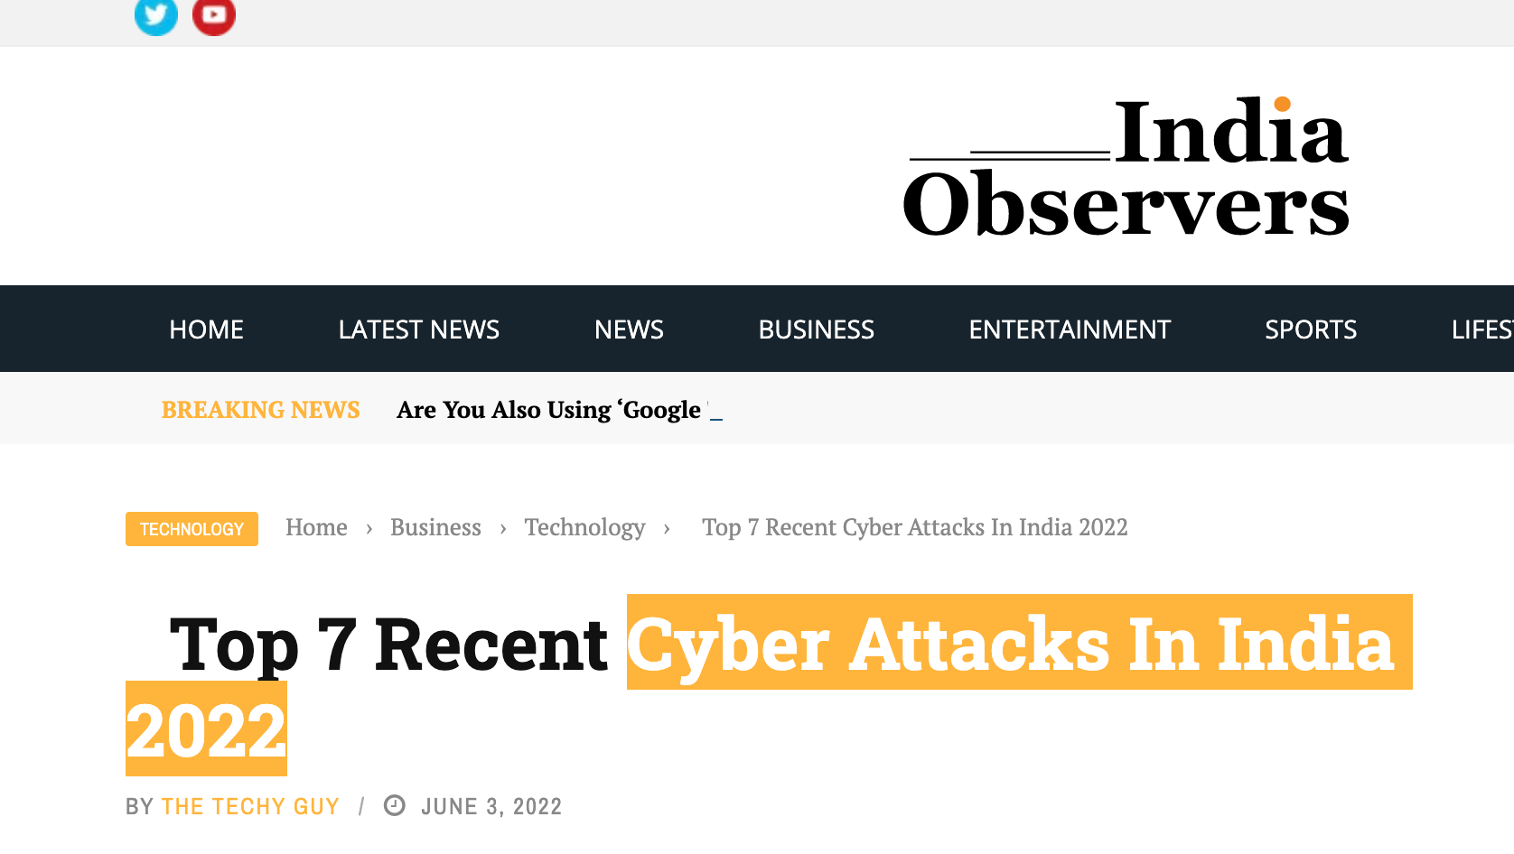
Cyberattacks in India (Top 7 recent attacks)
Razorpay: Lost Rs. 7.3 crores in unauthorized transactions
Amazon, Flipkart, Airtel & JioMart: Data of 10 crore users stoles due to cyberattack in Juspay
Oil India Ltd: Ransomware attack demanded Rs. 58 Crores
Tech Mahindra: Ransomware attack resulted in loss of Rs. 35 Crores
Mobikwik: 10 Crore user data put of dark web
Air India: Reportedly 45 Lac passenger data hacked
Domino’s: 18 cores order are put in public
AIIMS: ransomware attacks

Slide 4
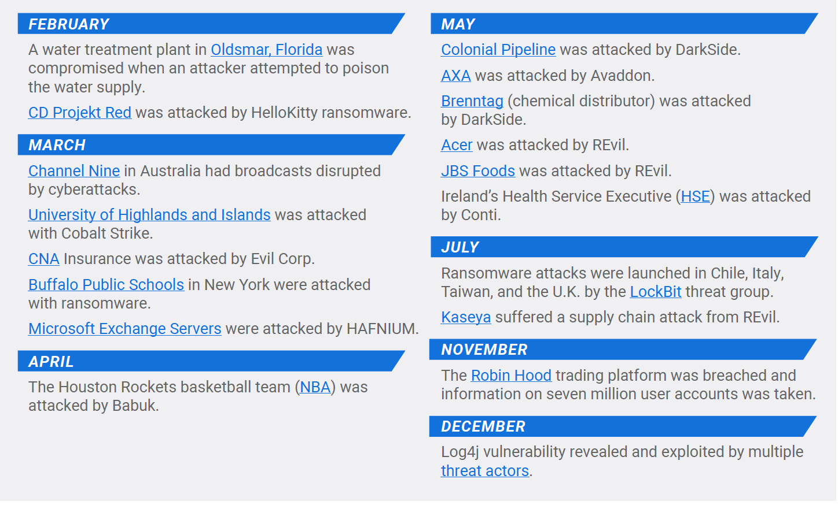
Cyberattacks in news
Source: The BlackBerry 2022 Threat Report

Slide 5
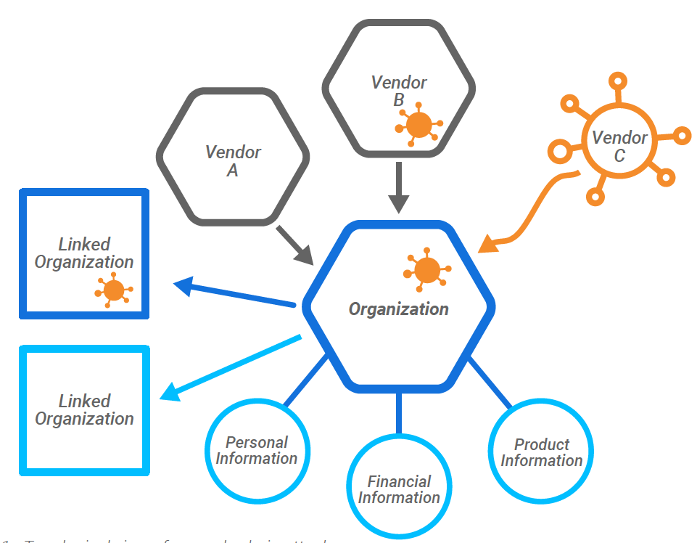
Supply Chain Attacks
Attackers look for path of least resistance
Supply chain represent the latest tradecraft
Trust is exploited!
The NotPetya ransomware attack (2017):
Compromised the Ukrainian tax software MEDoc
The SolarisWinds (2020):
Compromised Orion IT Management and monitoring software
Kaseya (2021):
Compromised Virtual System/Server Administration (VSA) server
Image: The BlackBerry 2022 Threat Report

Slide 6

Challenges in Detecting Malwares
Evade Antivirus: Changing behavior
Evade Static analysis: Use obscure programming language (Go, Nim, Rust)
Evade dynamic analysis: Can detect sandboxed environment
Hide deep inside: Software getting complex with too many dependencies
Adversarial training can defeat security tools
Appear genuine: Emergence of cloud and IoT make it easy to hide and propagate
source: TechRepublic
Way forward: Good network visibility and behavioral analysis can help

Slide 7
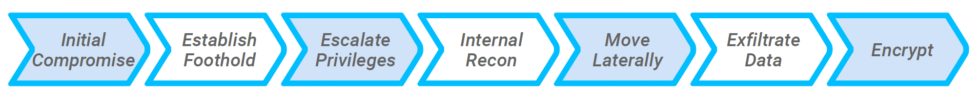
Attack Life Cycle
Advanced Persistent Threat group (low-and-slow)
Ransomware attacks (smash and grab)
The attackers users certain Tactics, Techniques and Procedures (TTP) are launch attacks

Slide 8
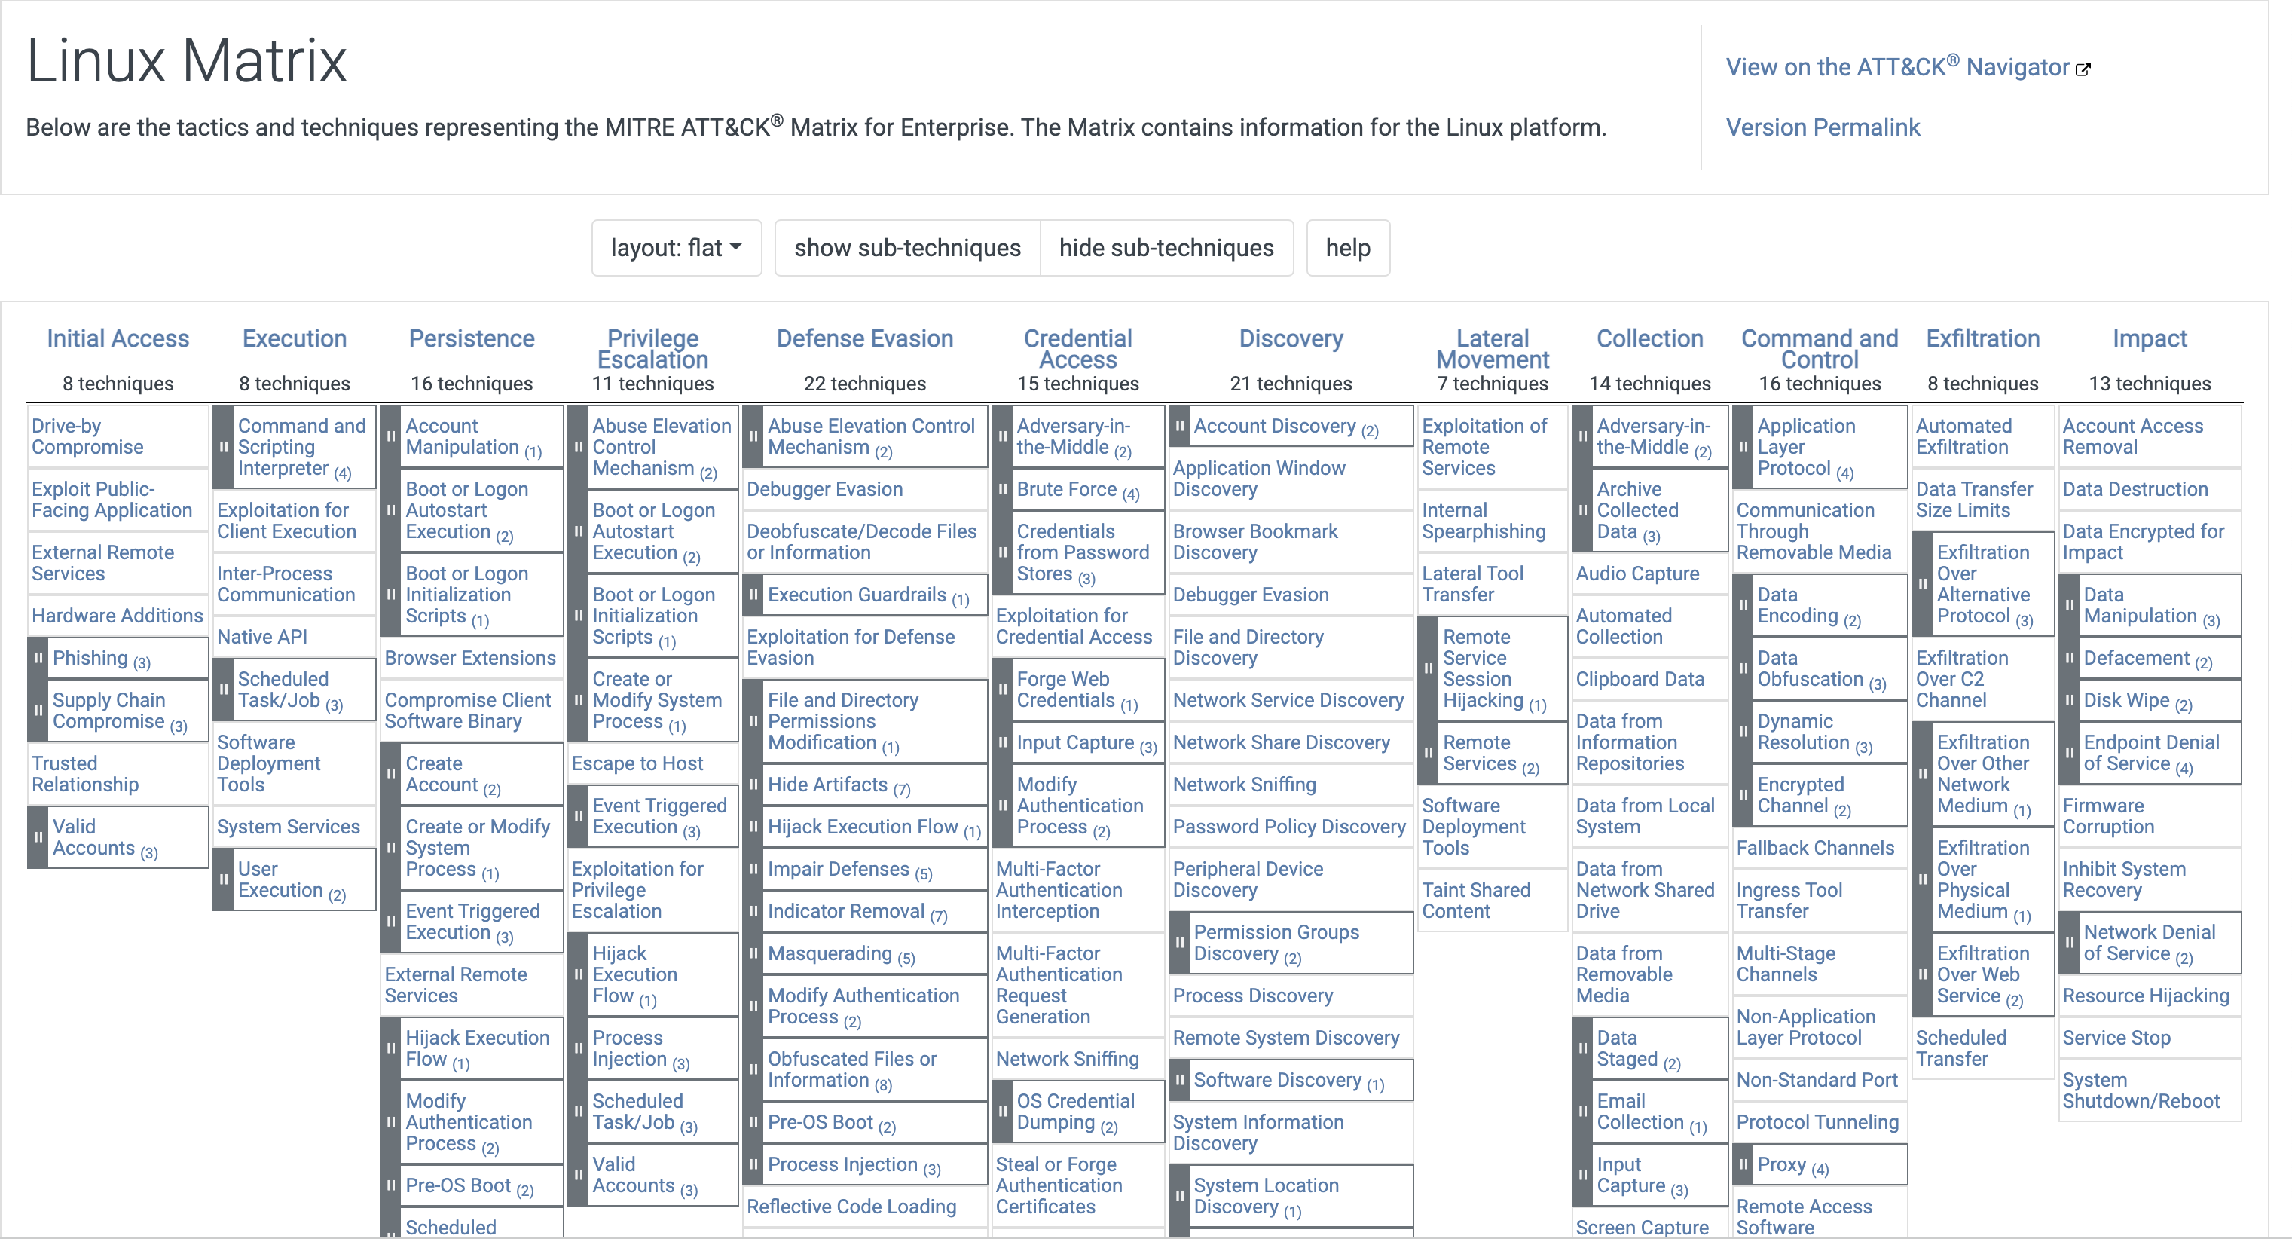
MITRE ATT&CK Framework

Slide 9


Good visibility of system logs:
Quality logs are important to to understand and detect threats:
Process events
File events
Socket/Network events
Hardware events
Etc.
Collection of required information from endpoints
Collection of Logs to a central location
Contextualization of logs and system state
Default Logging systems
Linux: Auditd
Windows: Sysmon and Event Tracer for Windows (ETW)

Slide 10
Contextualization of logs
Collection of required information from endpoints
Collection of logs to a central location
Contextualization logs and system state
Collection of required information from endpoints in the real time.
Contextualize collected data.
Customization of data to be collected on the fly.
Proprietary agents that hook kernel for real time logging are available
FortiEDR
Singularity by Sentinel
Carbon black

Slide 11

Osquery: Endpoint visibility
A data collection agent that is lightweight, configurable, easily accessible,
Created by Facebook
Abstracts OS as SQLite database
Snapshot view of OS State
Free and Open Source
Transferred to the Linux Foundation in 2019
Exposing an operating system as a high-performance
relational database.
Performant endpoint visibility
Query devices like a database
Fast and tested
Runs everywhere
Large-scale host monitoring
Kernel versions are taken care by Osquery!

Slide 12
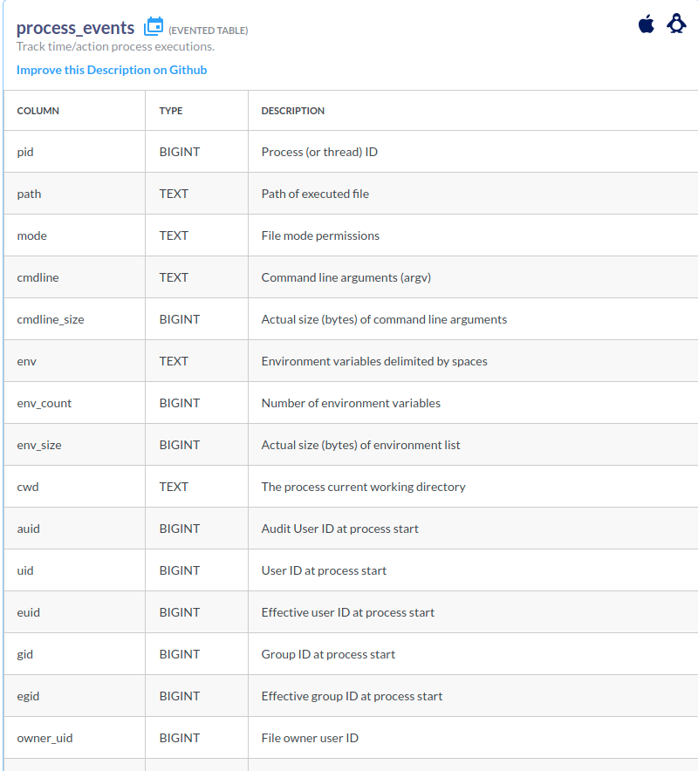
Osquery Schemas
Osquery uses SQL tables to represent abstract concepts such as
running processes
loaded kernel modules
open network connections
browser
Plugins
hardware events
file hashes
Total tables : 277
For Linux : 158
For Windows : 104
For MacOS : 191
For Free BSD : 53

Slide 13
Osquery Advantages
Exposing an operating system as a high-performance relational database
It delivers a single-agent solution using a universal query language to
collect rich datasets for multiple use cases
It’s a cross-platform application with support for recent versions of macOS,
Windows 10, CentOS, and Ubuntu.
Running queries no longer requires specialized expertise. One can write
SQL-based queries to explore data across all operating systems.
“SQL-powered operating system instrumentation, monitoring, and analytics”
Notes:
(Inotify and FAnotify?? No system call paramters)

Slide 14
Running Osquery
You can install osquery by compiling it from source, or from package manager.
osqueryi: The interactive osquery shell, for performing ad-hoc queries
osqueryd: A daemon for scheduling and running queries in the background.
osqueryi and osqueryd are independent tools.
They don’t communicate.
One can use one without the other.
Most of the flags and options needed to run each are the same

Slide 15
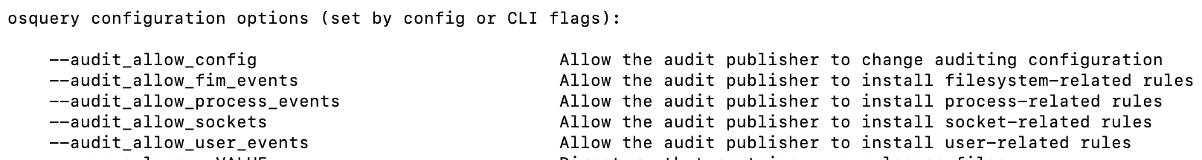
Configuring Osquery
Osquery is not a plug-and-play application. Whether one intend to use the interactive shell (Osqueryi) or the daemon (Osqueryd)
One can pass some flags and options, either from the command line or via a configuration file.
Dozens of command-line flags and configuration options are available
Creating a configuration file makes it easier to run osqueryi. It is located in /etc/osquery/osquery.conf. It is also available to the daemon.

Slide 16
Osquery Configuring File /etc/osquery/osquery.conf
Options: A list of daemon options and feature settings. Used by Osqueryi and Osqueryd.
Scheduled queries: A list of queries and when they should run.
Decorators: Special queries which prepend data to other scheduled queries.
For example: UUID of the host running osquery and the username of the user to every scheduled query.
Query Pack: A list of packs to be used to conduct more specific scheduled queries.

Slide 17
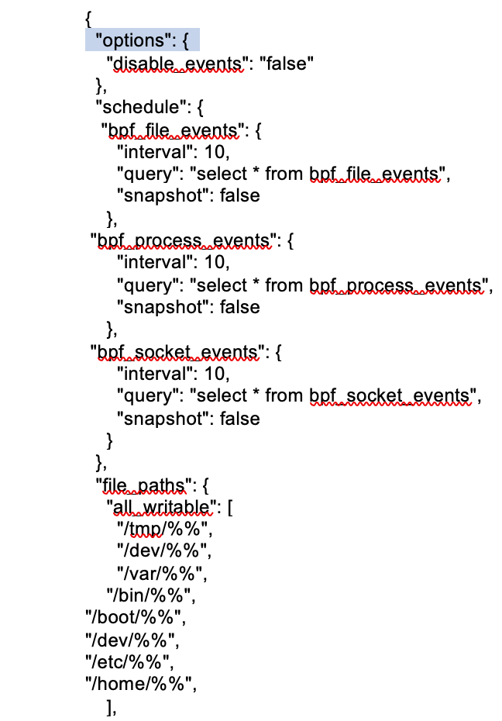
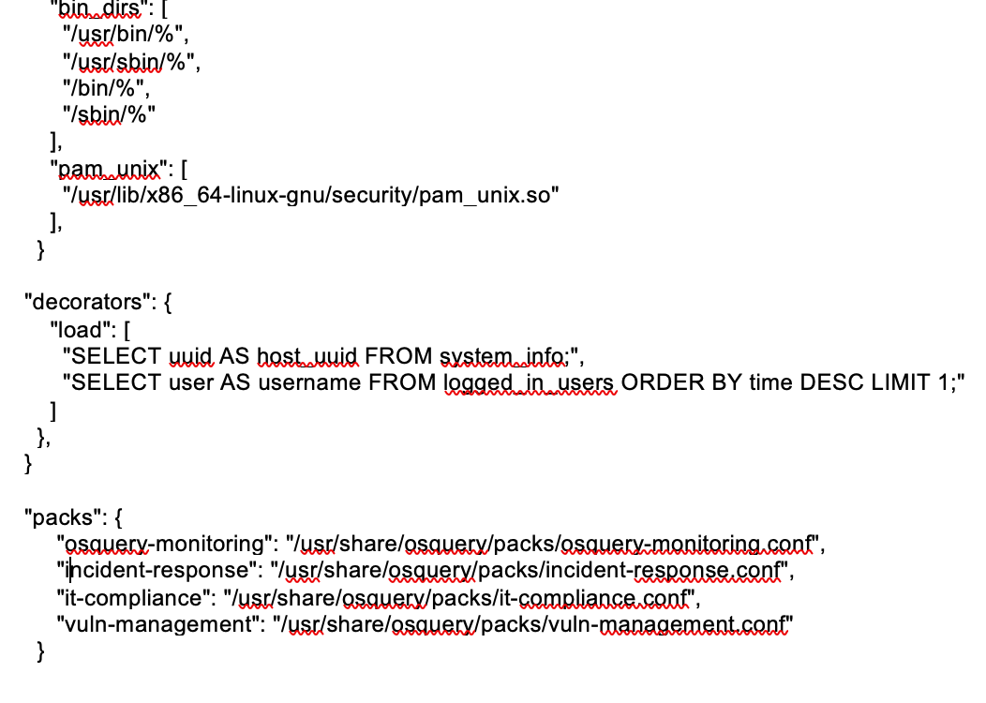
Example Configuring File

Slide 18
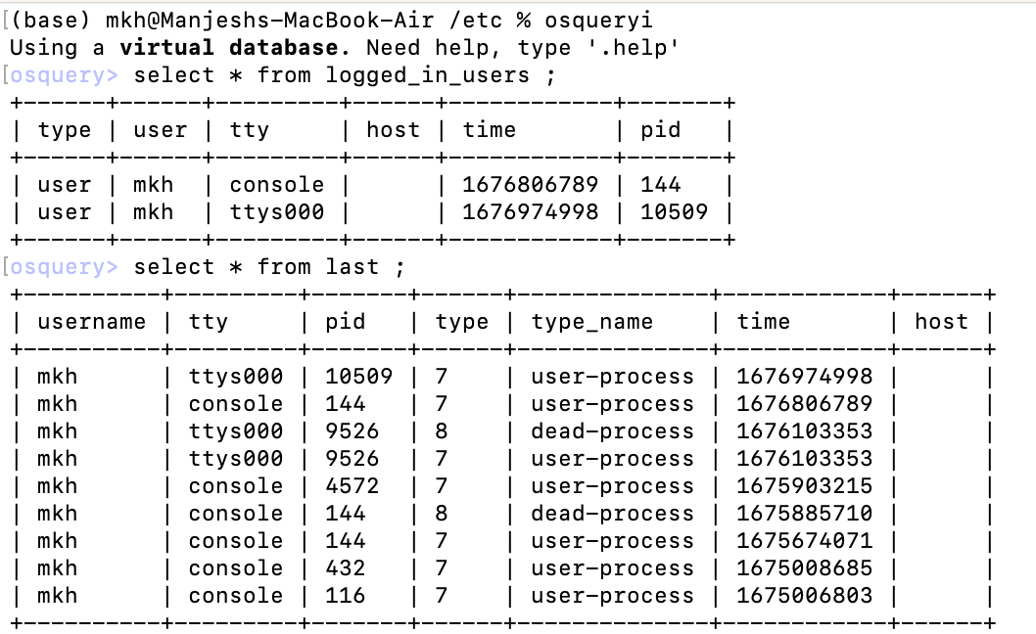
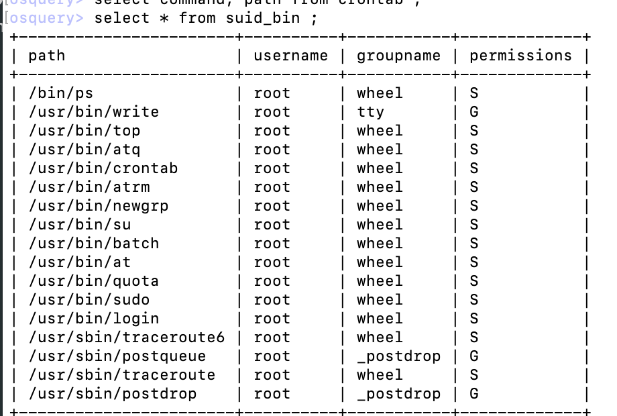
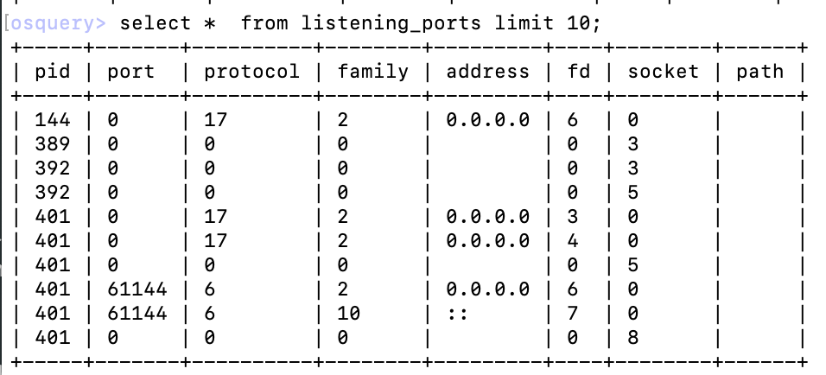
Use of Osqueryi
In an interactive shell allowing users to run SQL queries on OS
Used for ad-hoc queries and debugging
Do not persist between two sessions

Slide 19
Use of Osqueryd
Osquery is a daemon that runs continuously in the background
Real time monitoring and security analysis
Store data in database for later analysis
Required configuration details of what data to collect and where to store it
By default, data is published in file /var/log/osquery/osqueryd.results.log
It supports collection of logs from multiple devices at a central location

Slide 20
VAJRA
Indigenous End-point Detection and Response Tool for Securing End points

Slide 21
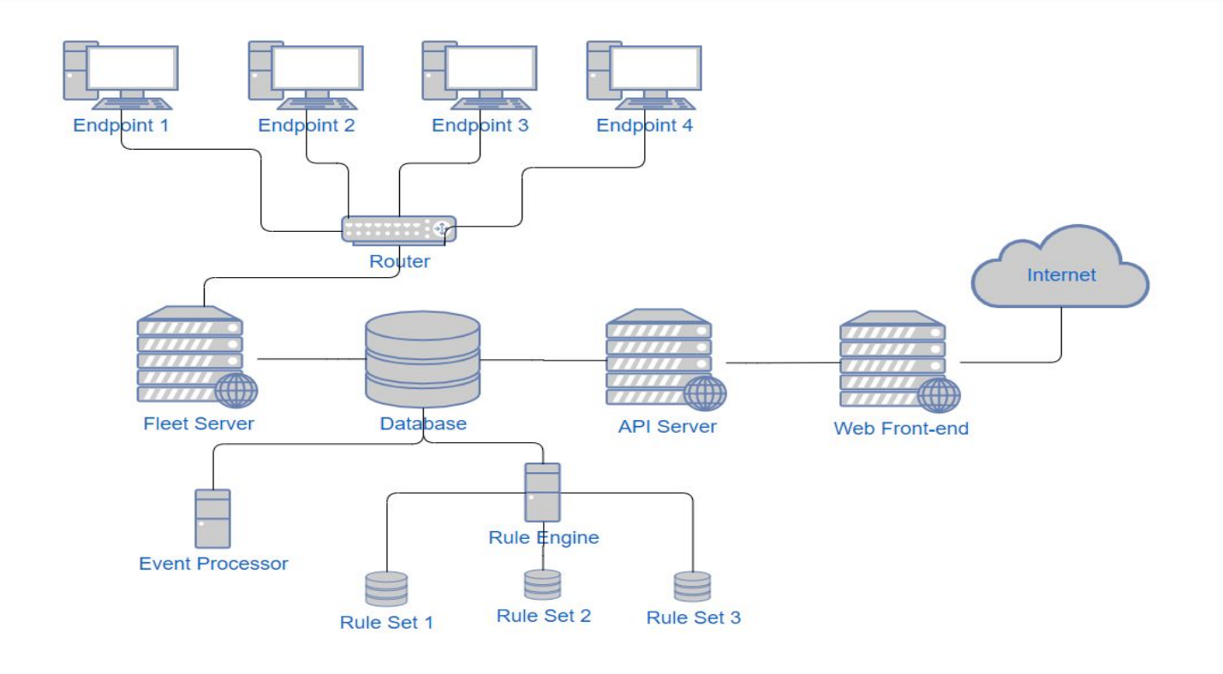
VAJRA Architecture
Endpoints with Vajra Agent
Fleet server
Database
Event processor
API server
Rule Engine
Web Management Console

Slide 22
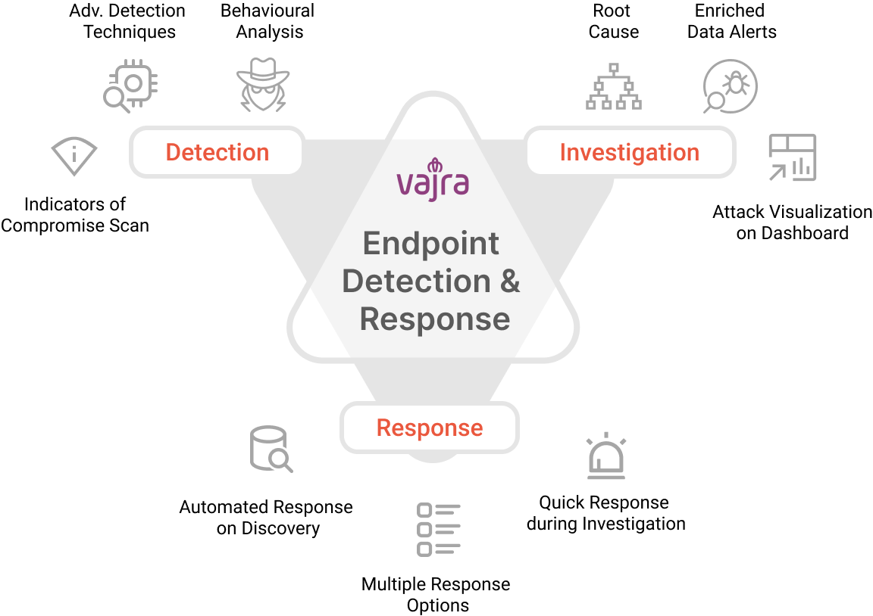


Features
Vajra agent
Custom Osquery (eBPF events)
Optimizes for low processor load
Fleet server
Scalable: Supports thousands of nodes
Can be cluster and load balancer config
Rule Engine
Covers most of TTP of MITRE ATT&CK of Linux and Windows
Notes:
Tactic Techniques and Procedures

Slide 23



Features
Effective monitoring and detection of threats in real-time.
Query information from the endpoint in the real time (Threat hunting).
Rule engine of Vajra is capable to analyze and detect threats in real time (Alert page).
Support for BOSS (agent)
Provide container visibility and detect container attacks
AI/ML based models automatic detection of new attacks

Slide 24
Role of AI and ML
Machine Learning (ML) is about Learning. Artificial Intelligence is about Intelligence.
Howe to use learnings to take intelligent actions?
Both AI and ML can play in differentiating normal and abnormal behaviors
Predict whether a particular behavior is associated with a user
Identify C2 communications
Detect Exfiltration activities
We can learn that user behavior pattern, but to declare it is malicious
we need intelligence!
Same techniques could be used by benign user and malicious users.
Minimize false alarms!
Chain the detected techniques across the tactics
do detect malicious behaviors (need threat intelligence)

Slide 25
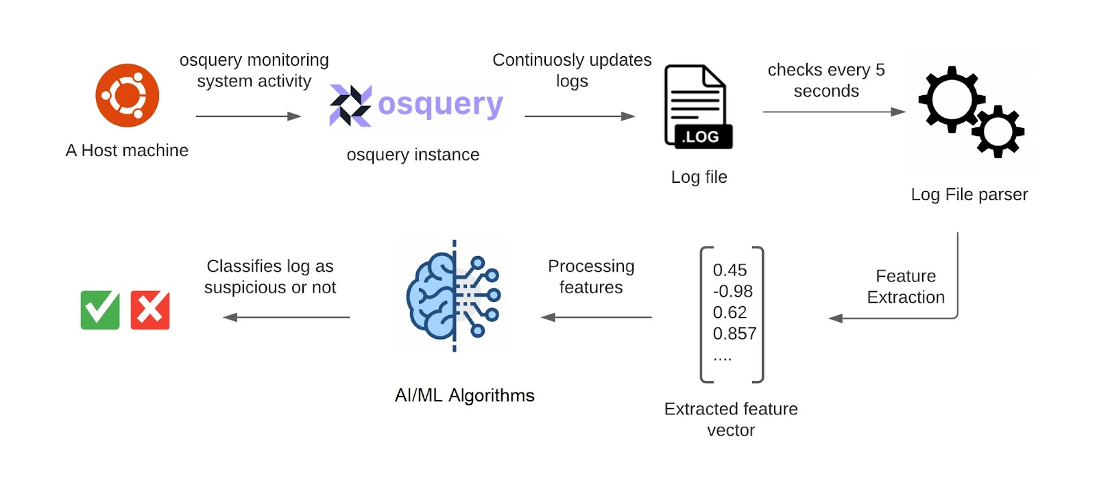
Sandbox: Malware Datasets and AI/ML Algorithms
Building Malware Datasets for training:
Creating Malware dataset by running malware samples
Osquery logs for both benign and malware samples
Parse Osquery logs to collect socket, process and
file events and convert into CSV file
Train AI/ML algorithms to detect attack
Threat detection algorithms:
If a rule-set is triggered, analyze the sample for malicious behavior
If not, check with AI/ML algorithms for malicious behavior

Slide 26
Thank you Contact: mhanawal@iitb.ac.in

